Slide 1
Summary of AAAI Fall Symposium on Integrating Cognitive Architectures and Generative Models
Christian Lebiere (cl@cmu.edu)
Psychology Department
Carnegie Mellon University

Slide 2
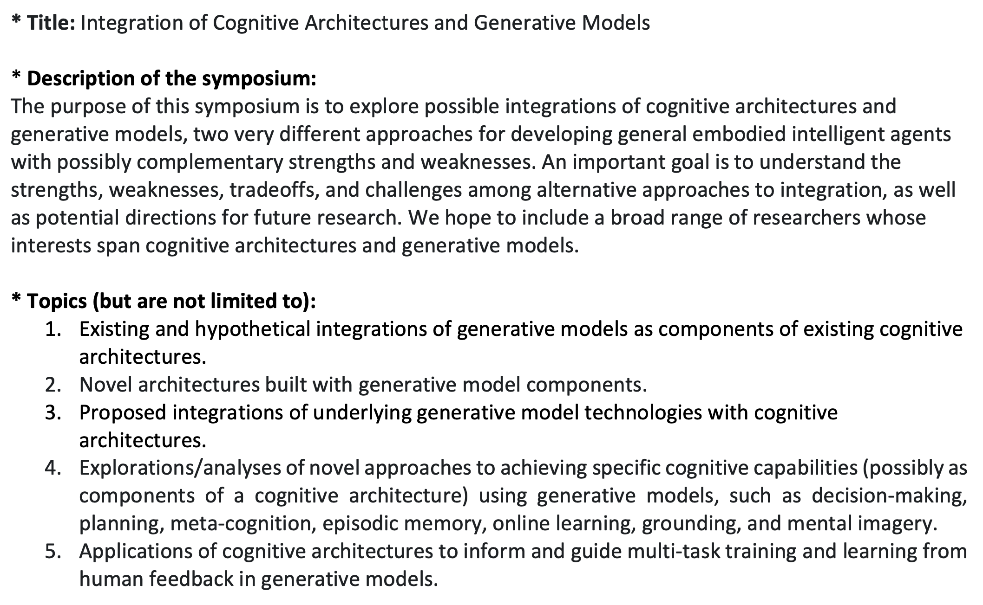
Symposium Announcement

Slide 3
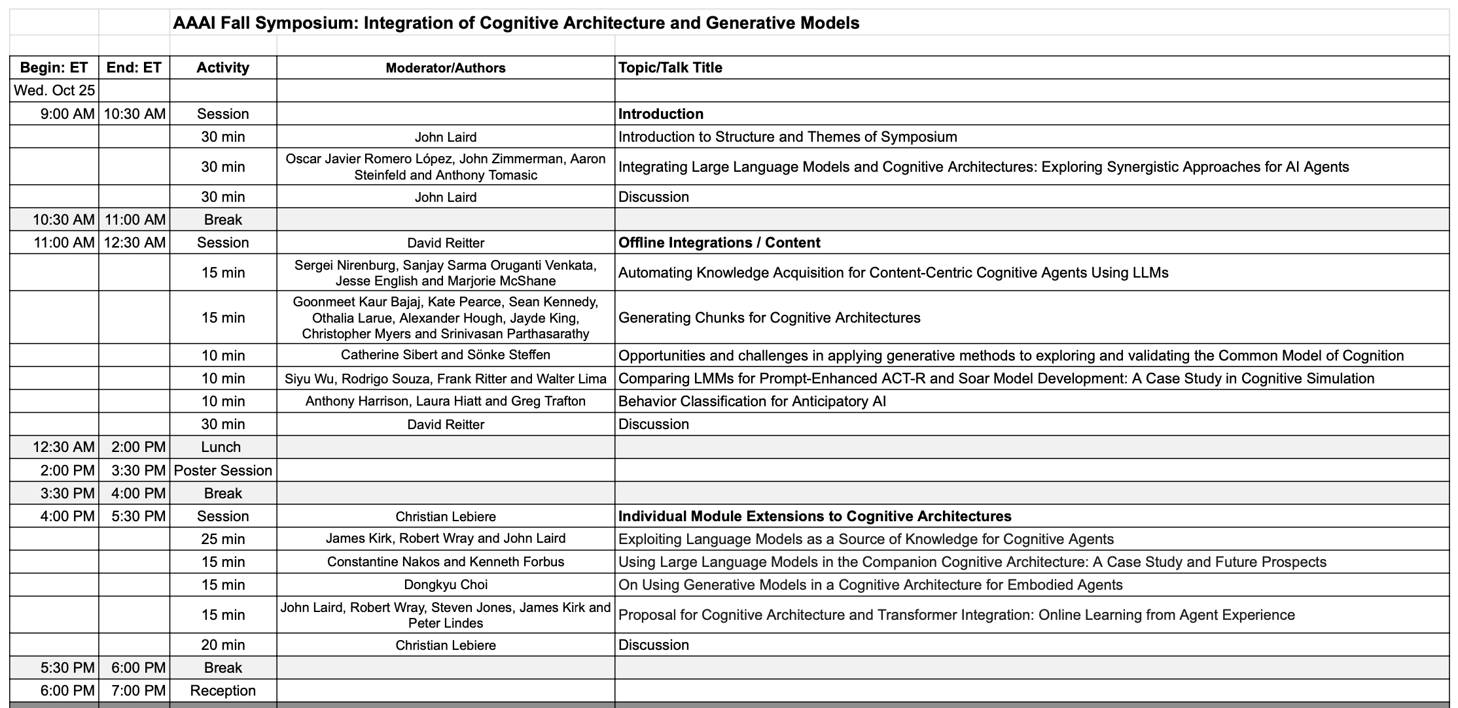
Session 1: Introduction

Slide 4
Introduction (John Laird)
Cognitive Architectures
Large Language Models
Established approach for embodied, goal-driven agents
No redesign or custom code required for new tasks
Integrates multiple types of knowledge, representations, efficient real-time reasoning, planning, and online learning
Limitations:
Limited innate pre-trained knowledge
No innate language capabilities
Difficulty capturing general regularities in its experience
No innate perception and motor capabilities
Massive body of context-dependent pre-trained knowledge with some generalization
Amazing fluency across a broad range of language and related capabilities
Continually improved via massive commercial investment
Potential for transduction of vision and motor
Limitations:
Require custom/ad hoc architecture and prompts for realizing advanced capabilities
Potential for incorrect, irrelevant, generic responses
No online learning: no memory of experiences
No internal reasoning over different knowledge representations and grounding of words to perception
Computationally expensive for real-time behavior

Slide 5
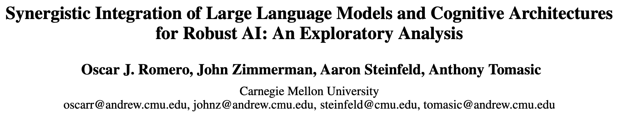
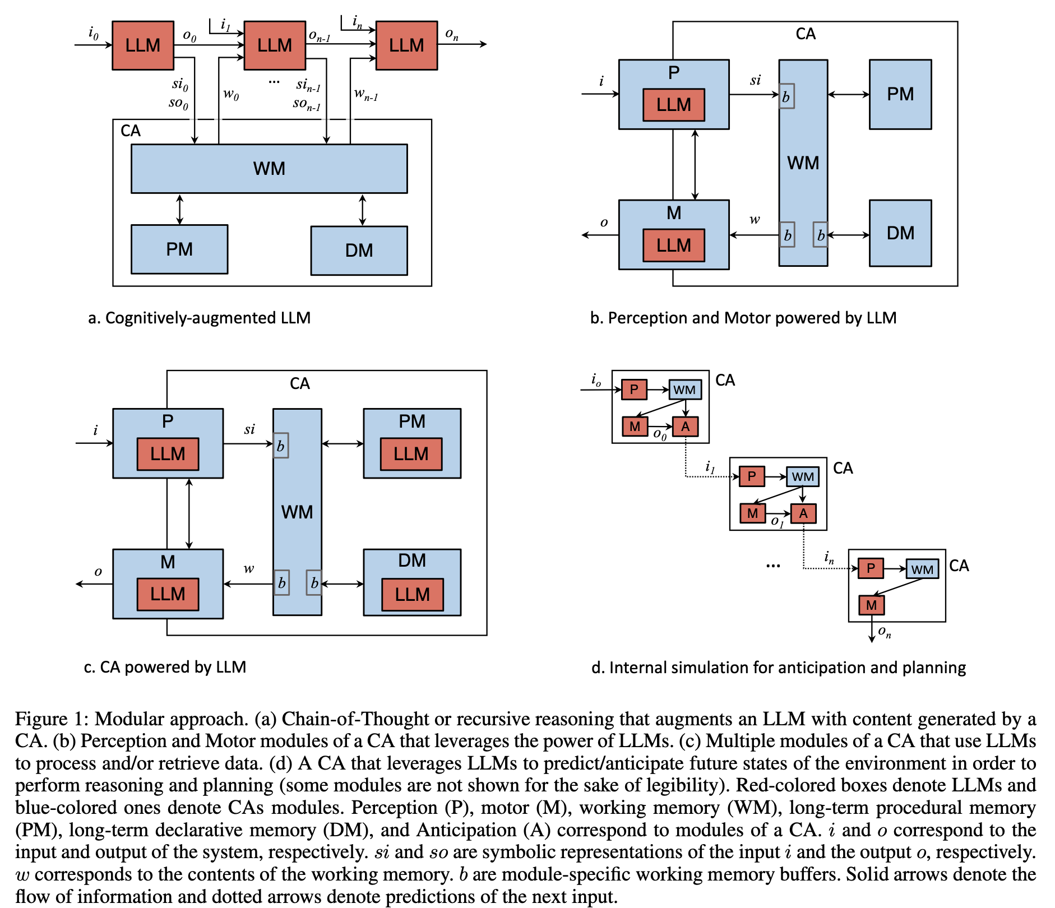
Integration Approaches
Use case: cell phone-based cognitive agent for visually impaired assistance
Modular Approaches
Augment LLM CoT with CA reasoning
CA for consistency and commonsense checking
Multimodal LLMs for CA perception-action
Generate and act on abstract world descriptions
Generalize LLMs use to other CA modules
Knowledge for declarative/procedural memories
Use LLMs for internal CA simulation
LLMs as world models
Central role of WM vs context window

Slide 6
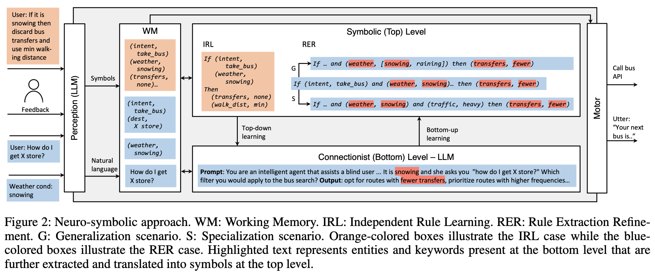
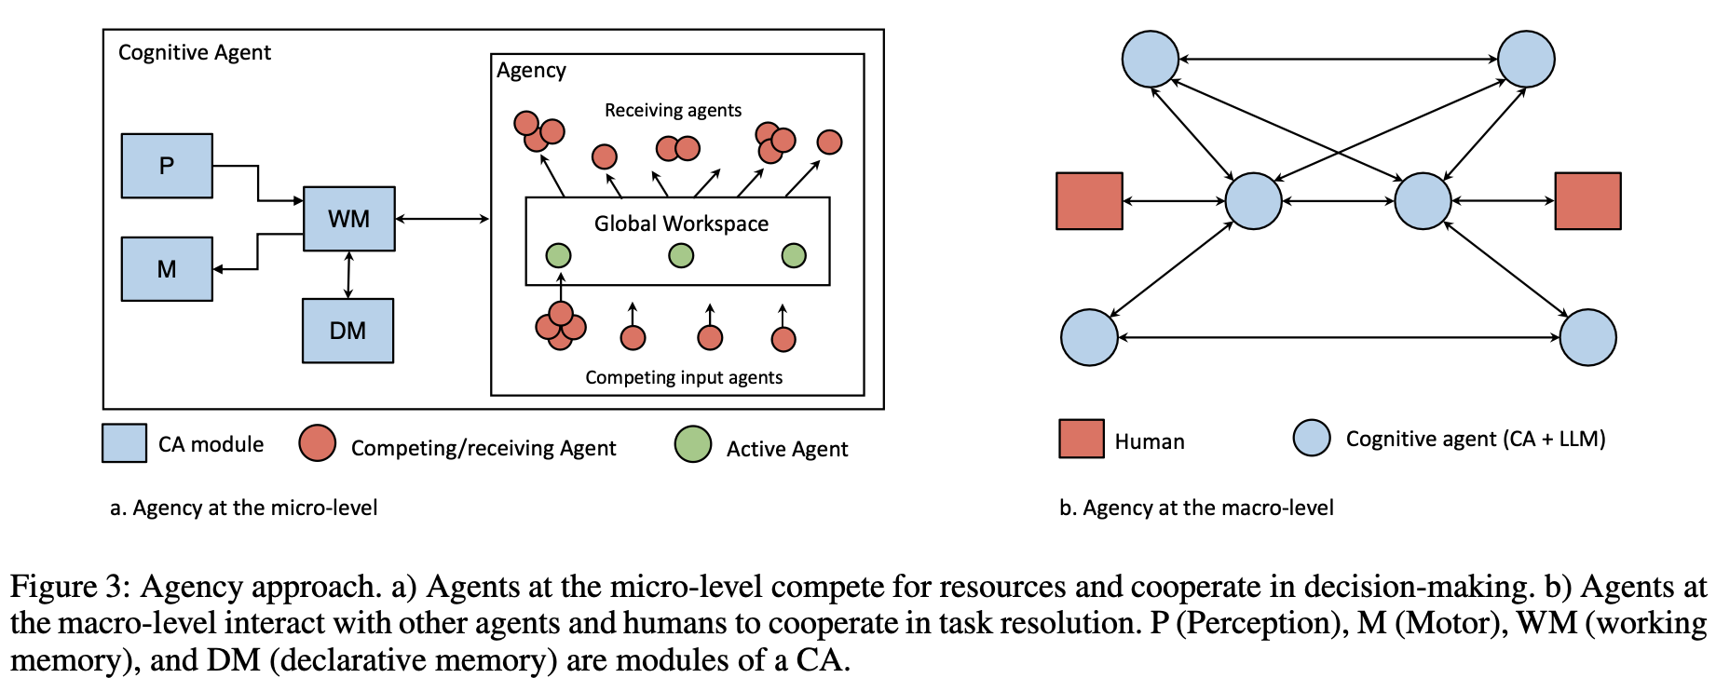
Other Approaches
Neuro-Symbolic Approach
CLARION dual symbolic-neural levels
Generation of symbolic rules from external instructions (IRL) and abstraction of neural patterns (RER)
Top down guidance through prompt engineering by symbolic productions
Agency Approach
Mixed specialized CA/LLM micro-agents (a la Society of Mind/Wisdom of Crowds) synchronized through Global Workspace
Macro-level agents as cognitive twins supporting user interactions

Slide 7
Session 2: Offline Knowledge Generation

Slide 8
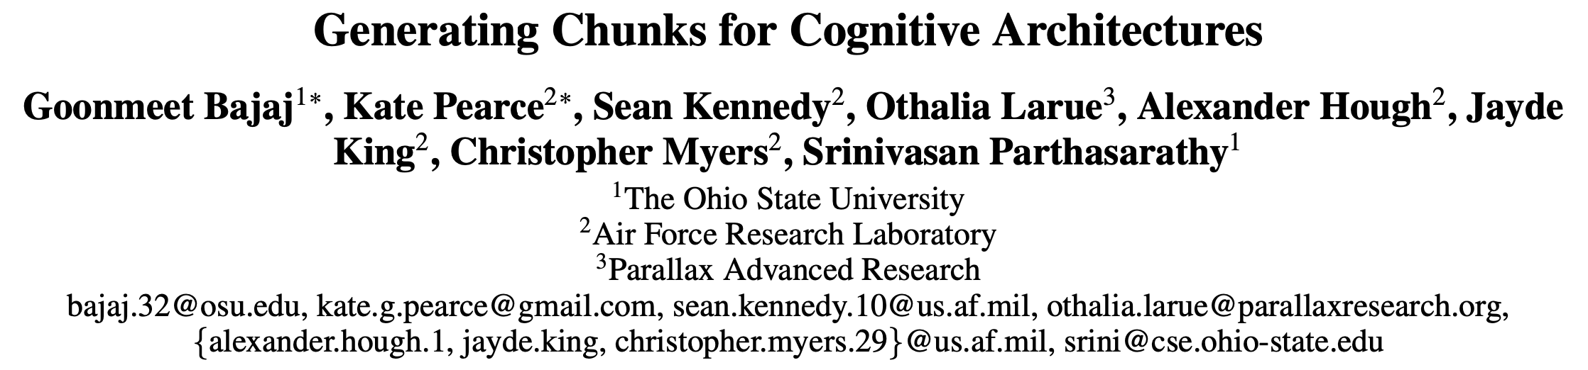
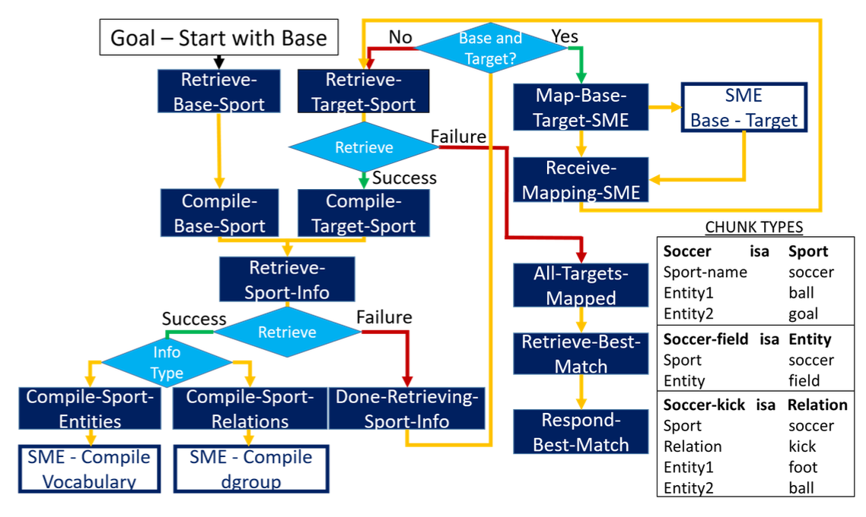
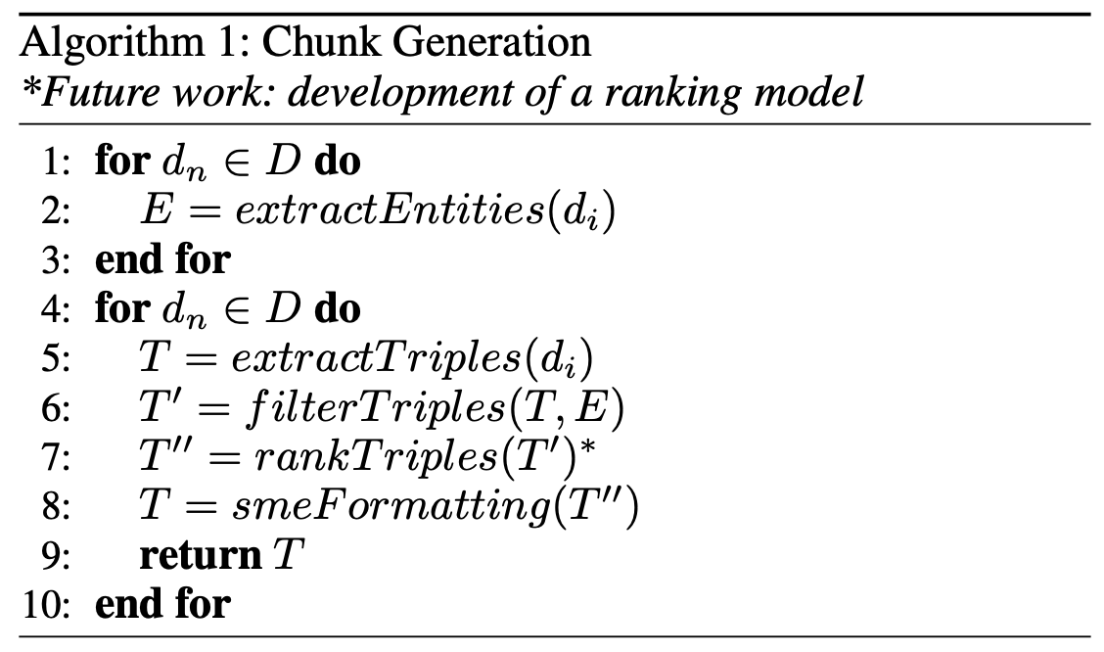
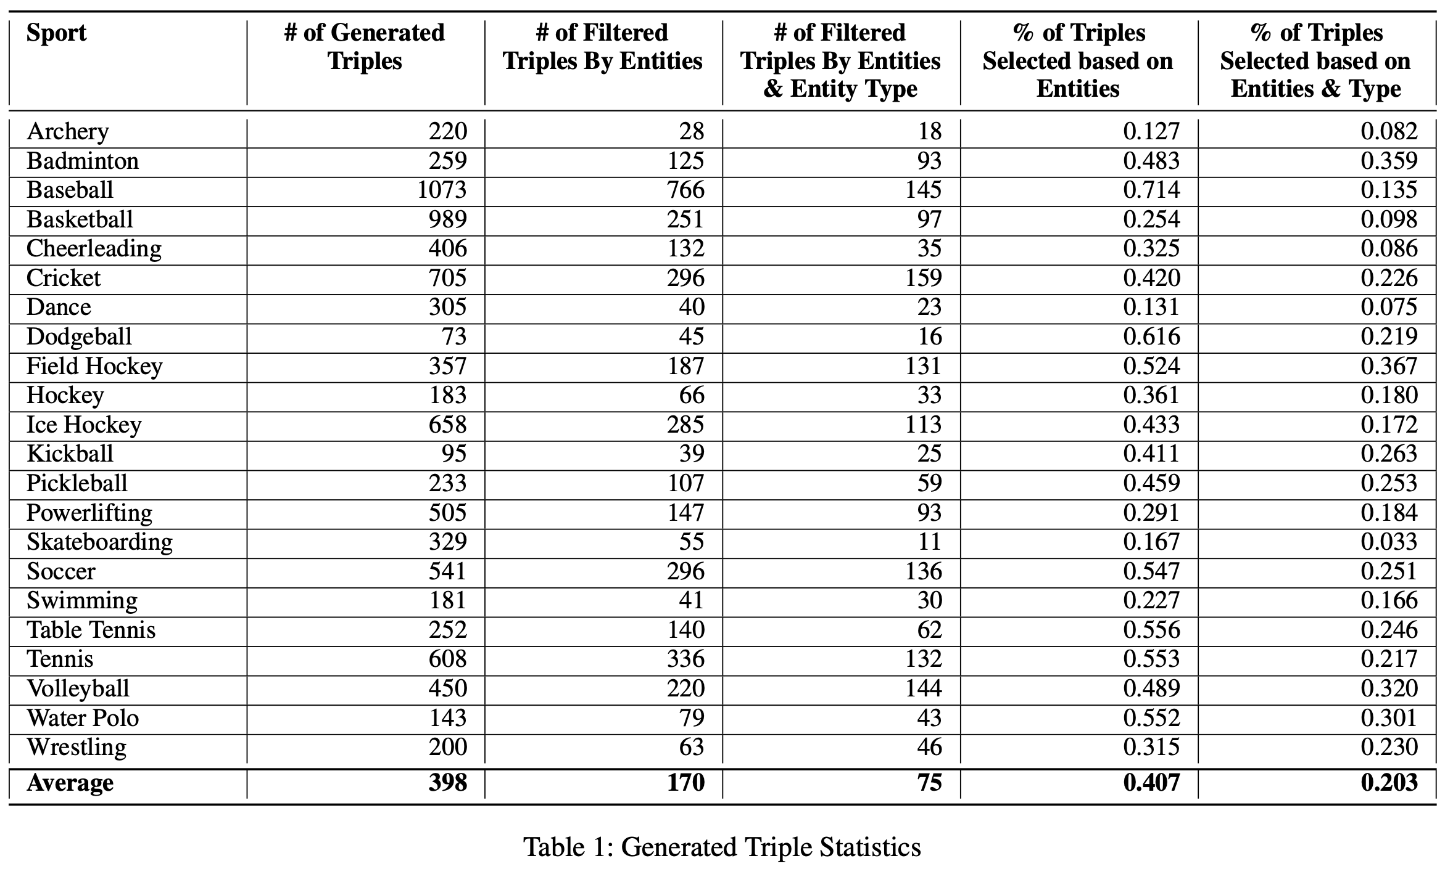
Knowledge Ontologies
Analogy process: retrieval, mapping, abstraction, generalization
Knowledge engineering bottleneck
Improve tailorability and generality
Extract triple chunks from free text
Subject-relation-object
Sentiment and confidence scores
Filter triples based on entities
Filter based on object/subject types
Compute structural similarity scores

Slide 9
Session 3: Online Knowledge Extraction

Slide 10
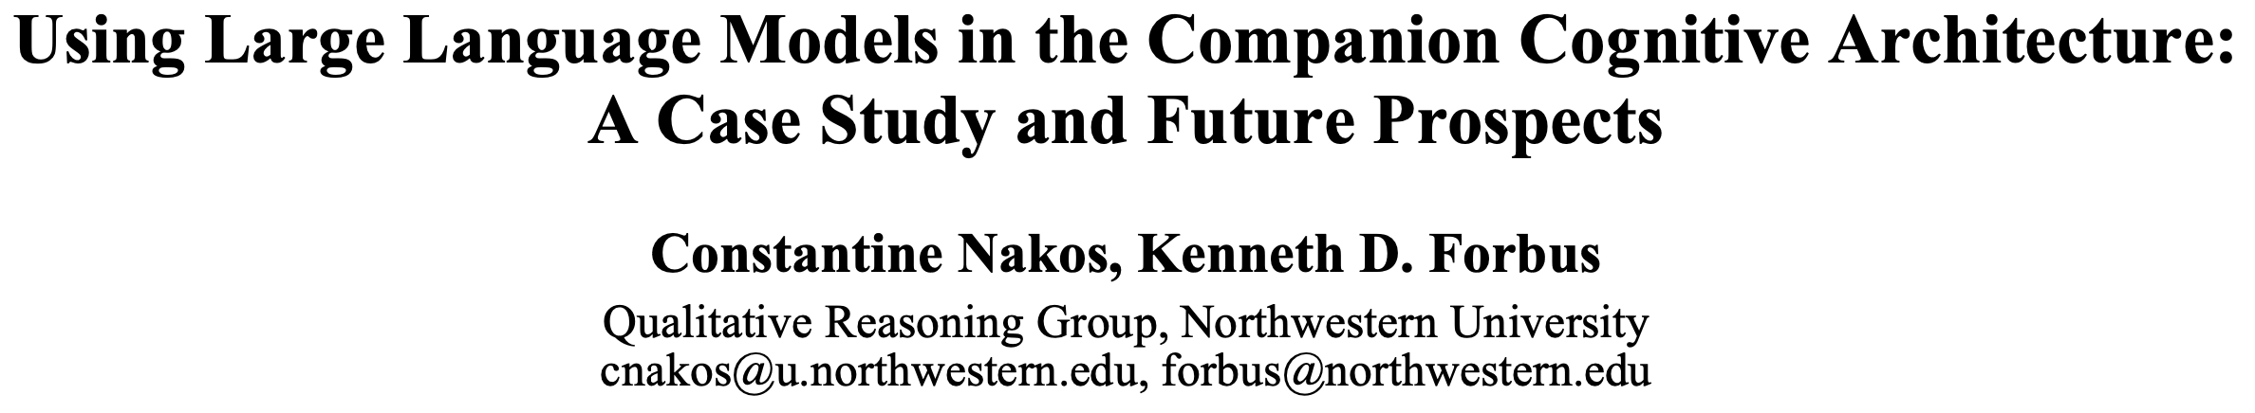
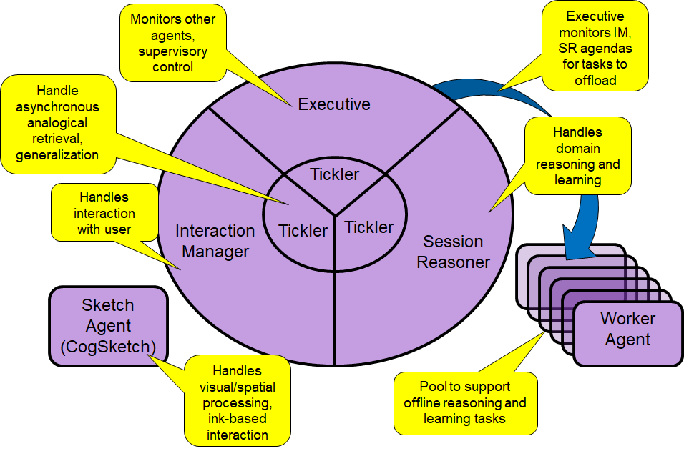
Knowledge Acquisition
CNLU a rule-based semantic parser
CycL representation grounded in NextKB
FrameNet2 lexical semantic mappings
task constraints to guide abduction, using domain-specific rules or analogical Q/A
Inspectable but disambiguation & coverage
Use LLM (BERT) to augment analogy
LLM as frame classifier for disambiguation
Predict fact plausibility (poor in isolation)
Future uses
Finer-grained disambiguation (NextKB)
Simplifying text inputs for semantic parser
Bypass parser and generate predicates

Slide 11
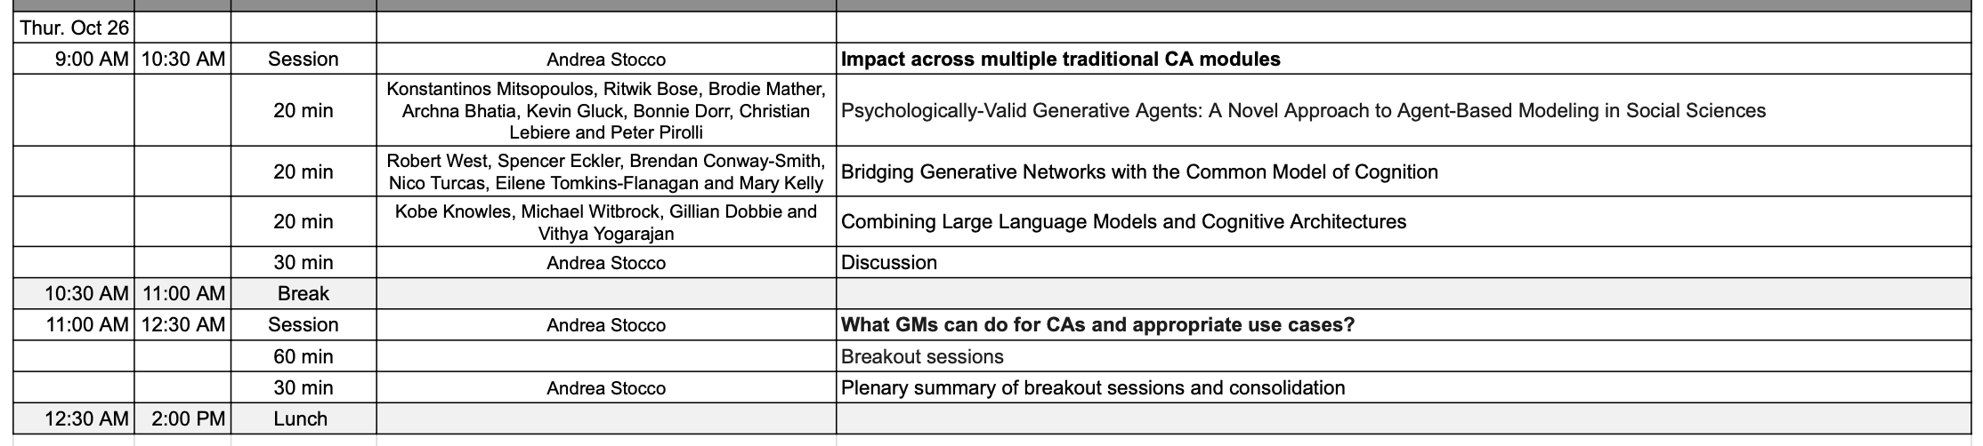
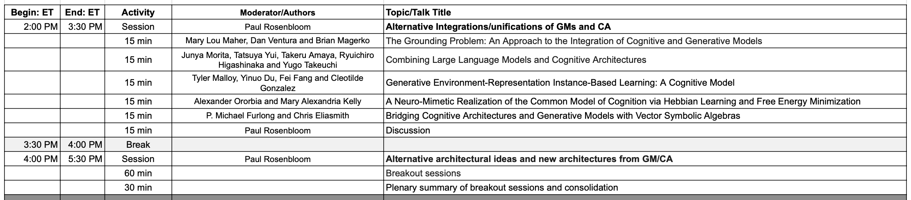
Session 4: Architectural Integration

Slide 12
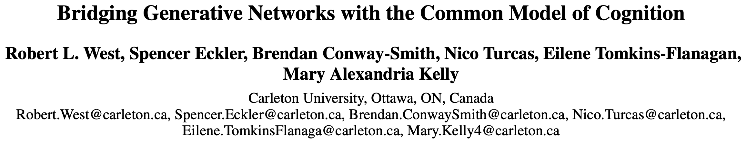
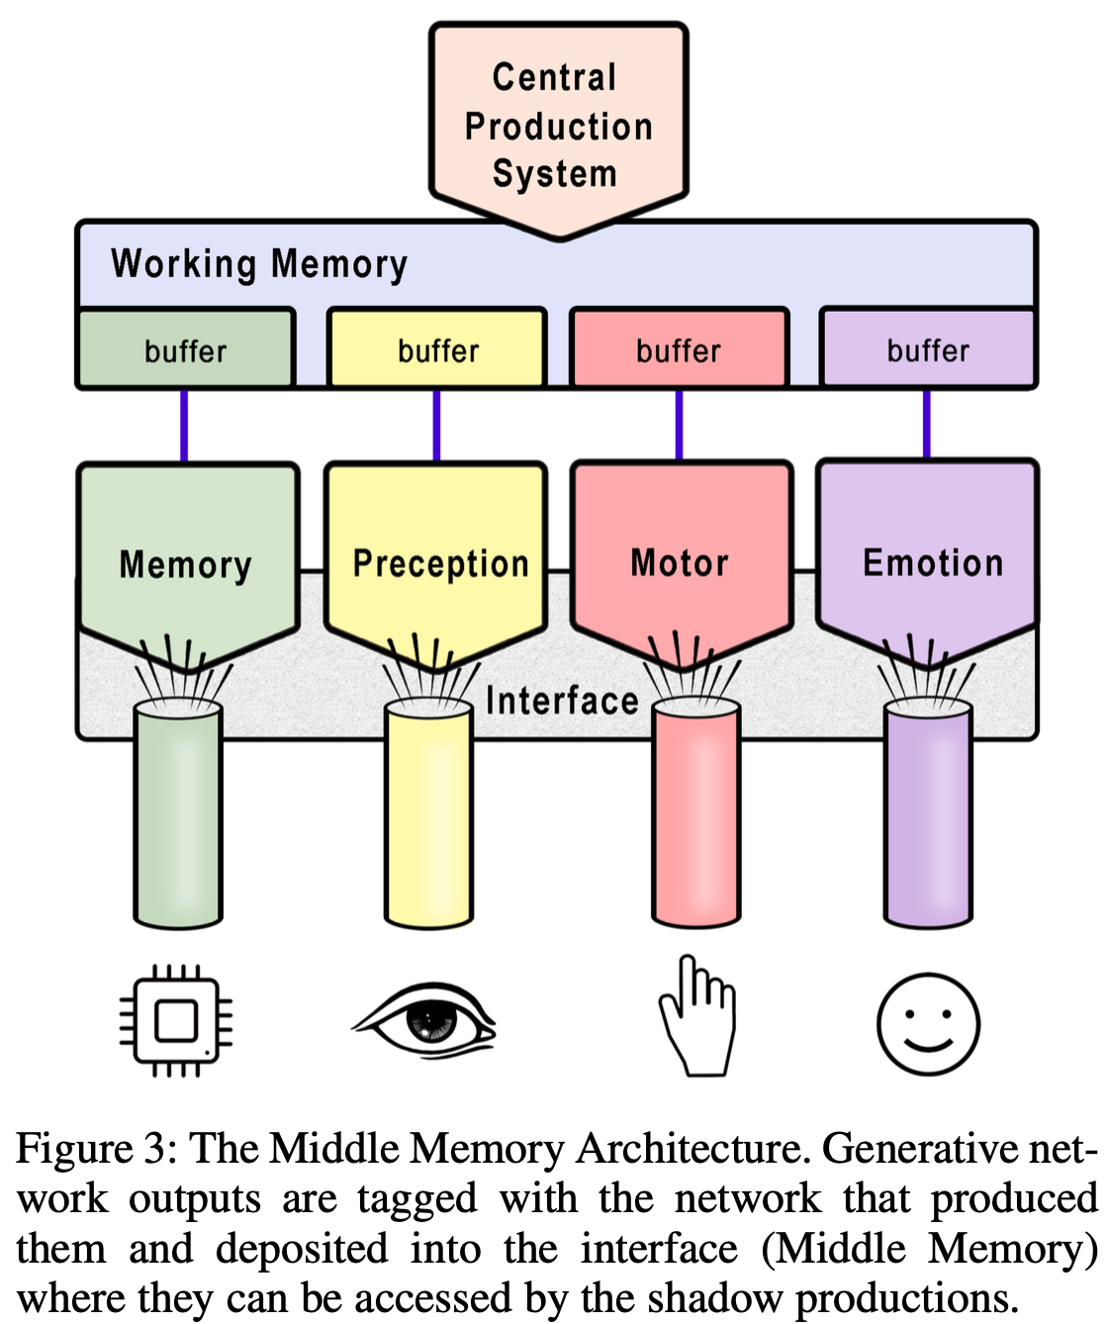
Bridging Paradigms
Modules as generative pre-trained networks
Central production bottleneck
Shadow productions in peripheral modules
Monitor signals in low-level modules
Manage attention and WM context
Handles (de)tokenization functionality
Middle Memory
Assigns activation values to bottom-up vectors
Stores top-down context in graph structures
Provide attentional context to generative models
Reinforce shadow productions from patterns

Slide 13

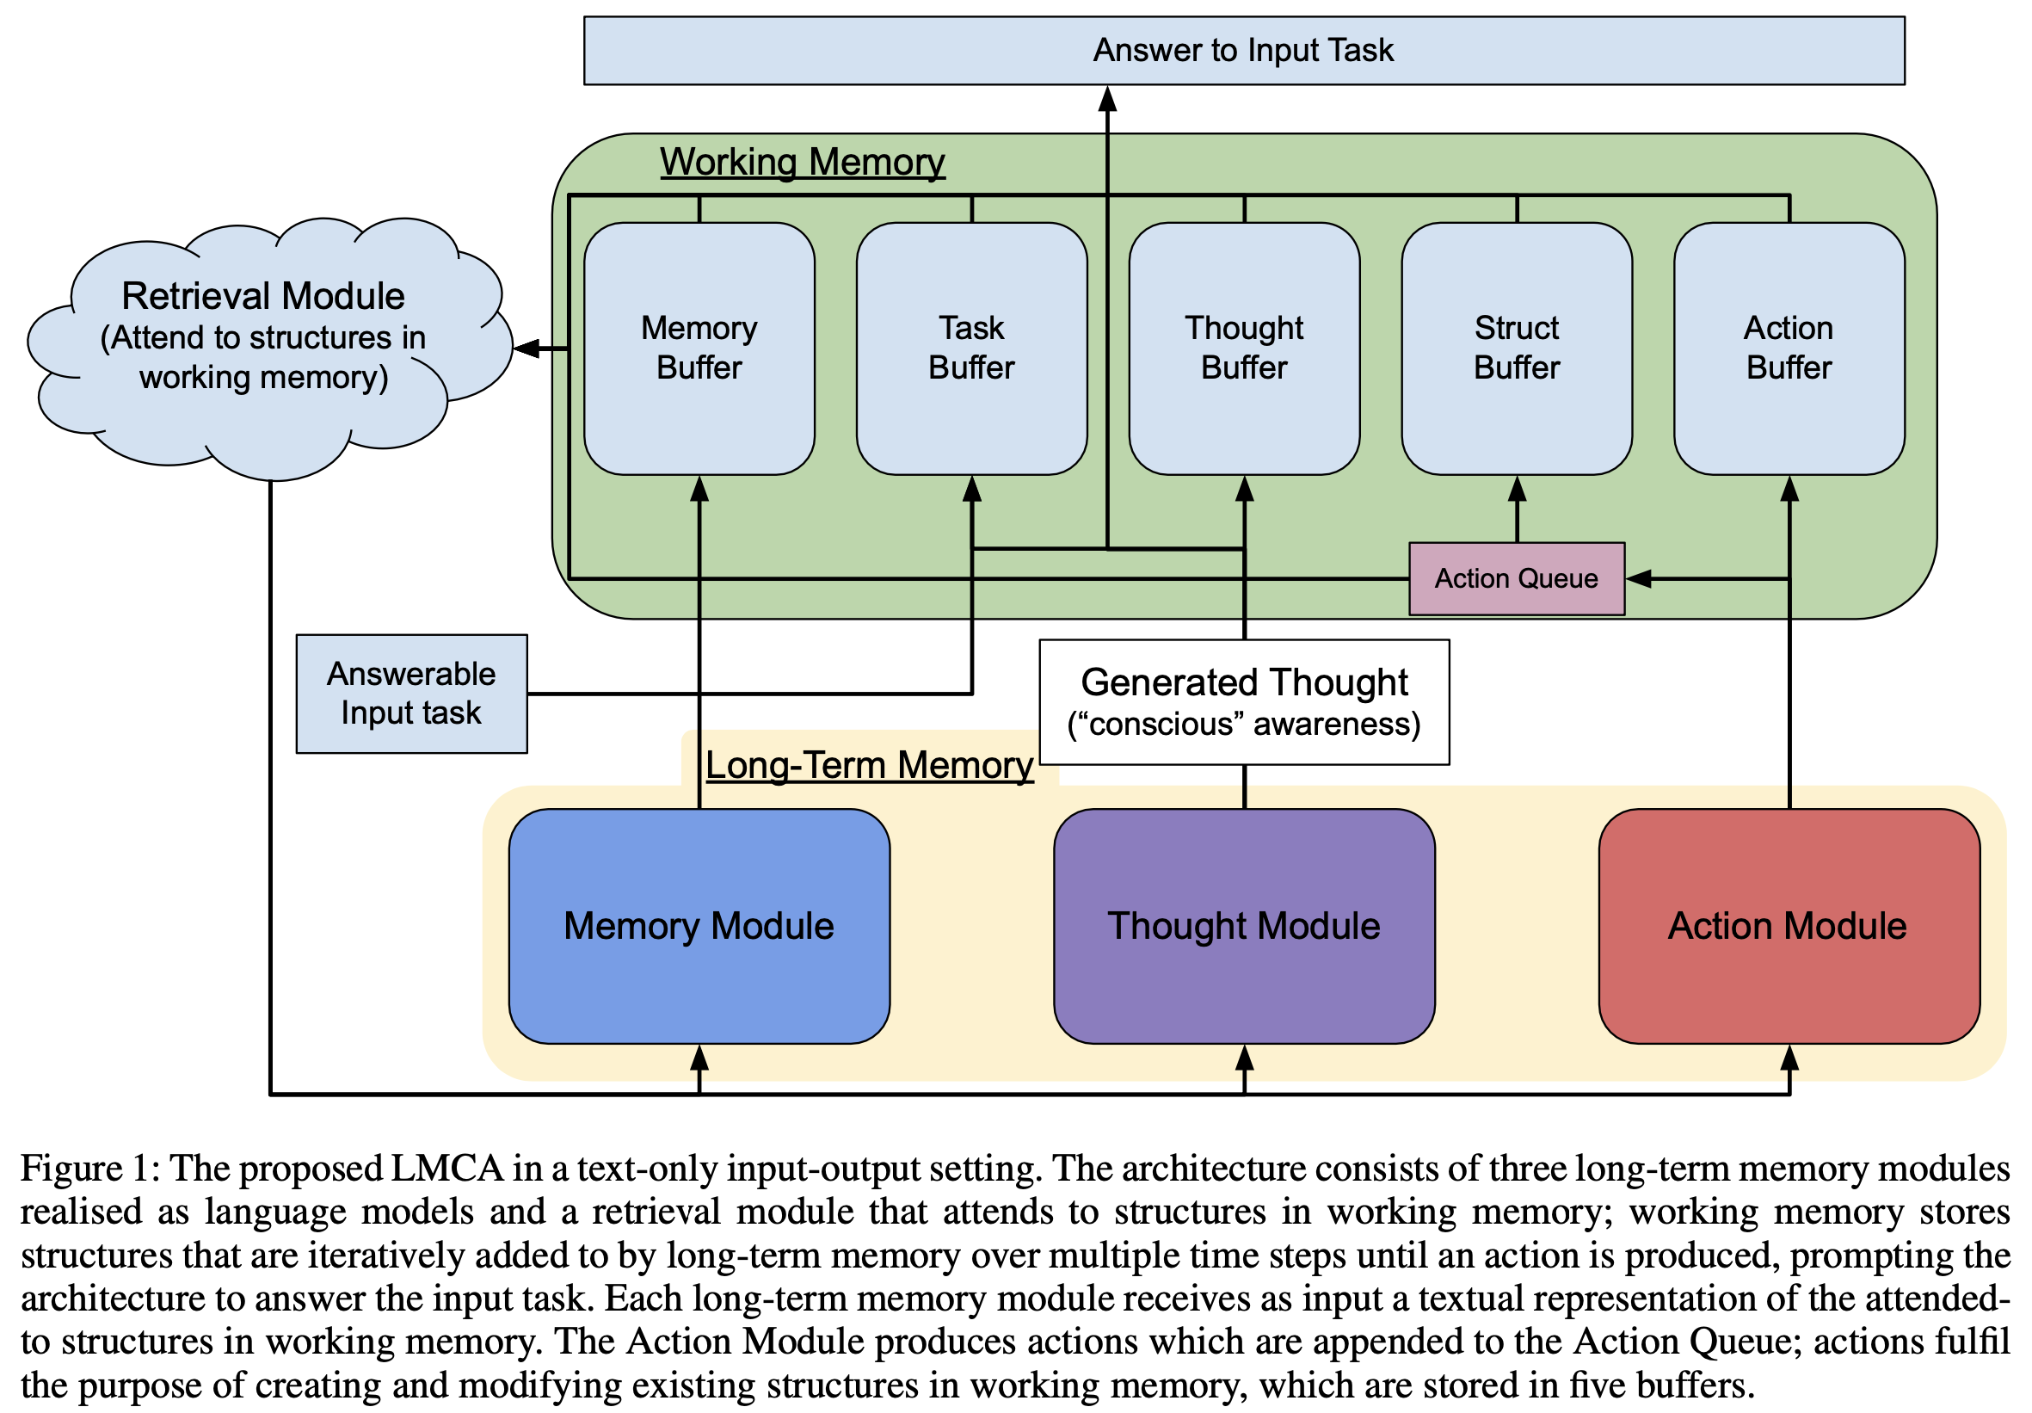
Language-Based Cognition
LLMs akin to System 1 - need System 2
No backtracking in next token prediction
Lack of reasoning and planning abilities
Add Language Model-Based Cognition
Used for textual input-output settings
LLMs used for 3 long-term memories
Memory module retrieves based on context
Thought module monitors and regulates
Action module maintains structures in WM
Retrieval module attends to WM structures
Provides context to other modules
Augment pre-trained modules
Instructions, reinforcement, online learning

Slide 14
Session 5: Alternative Architectures

Slide 15
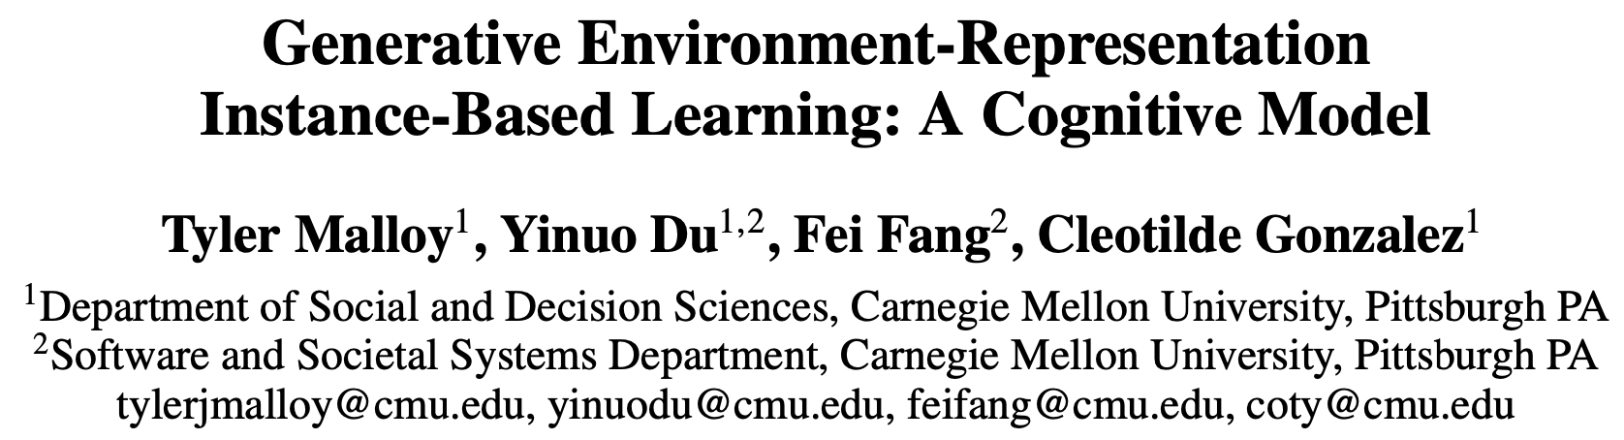
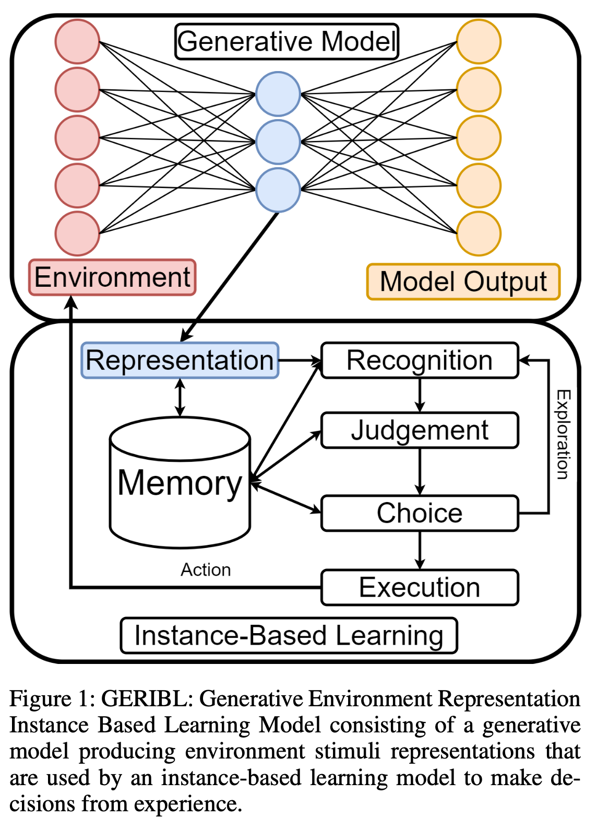
Grounding Representations
Instance-Based Learning modeling
General methodology for modeling decision making
Scalability issues with feature-based representation
Need similarity metrics for feature dimensions
Generate embedding with generative model
Trained to extract underlying causal regularities
Evaluate 3 classes of generative models
Variational Autoencoders (VAEs)
Generative Adversarial Networks (GANs)
Visual Transformers (ViT)
Set similarity metrics from vector representations
Learn attentional weights from feature utility

Slide 16
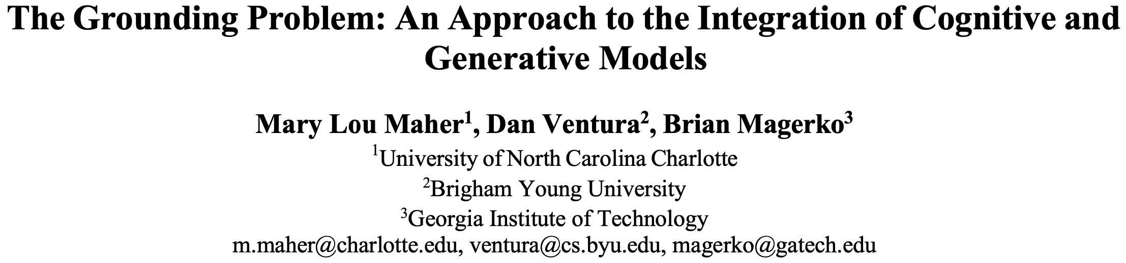
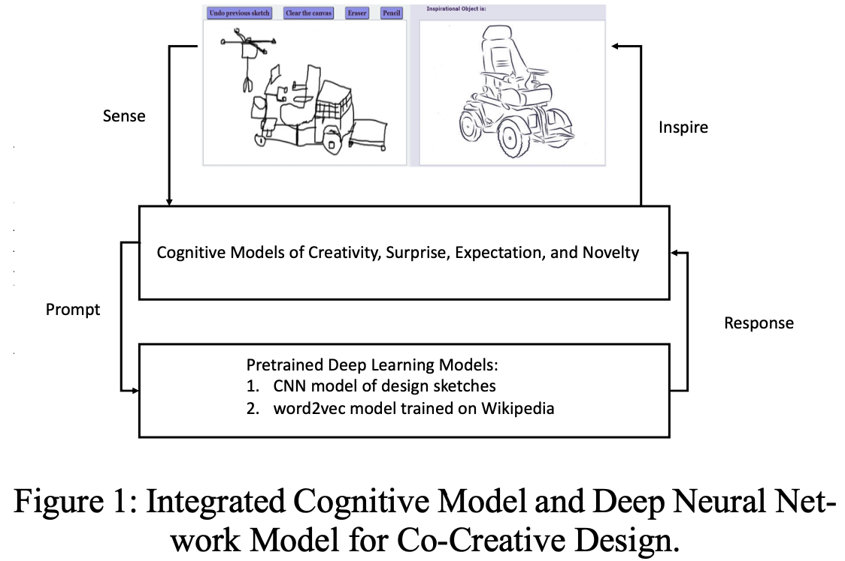
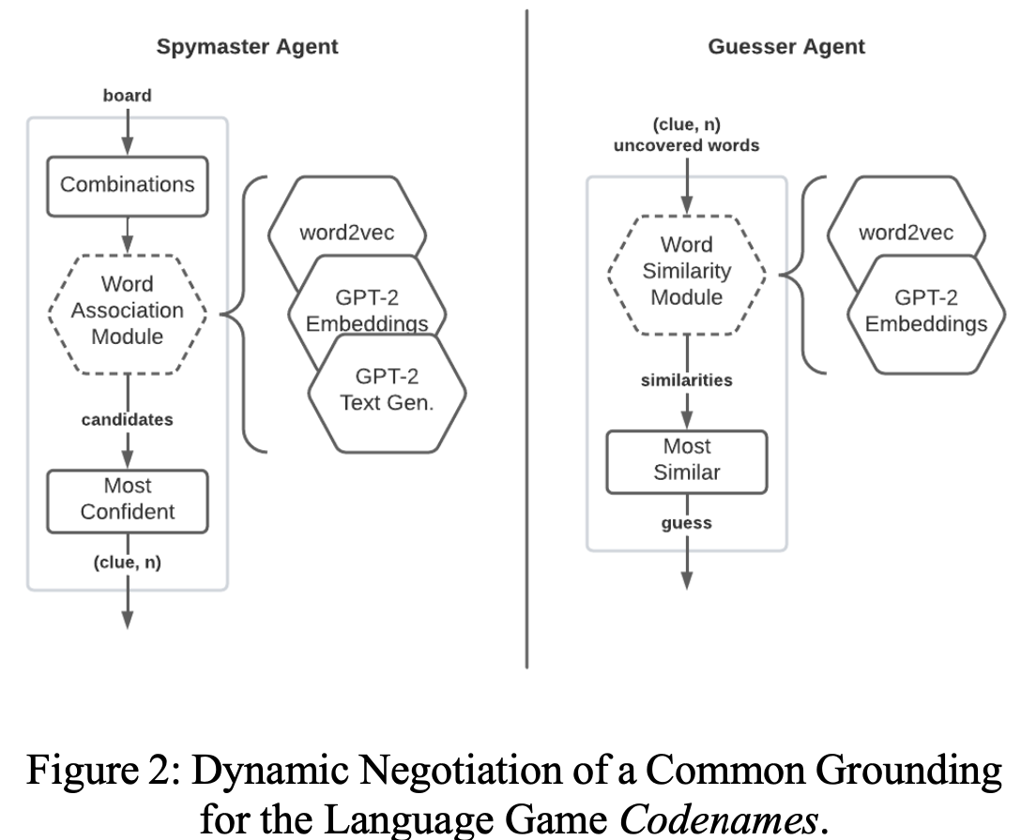
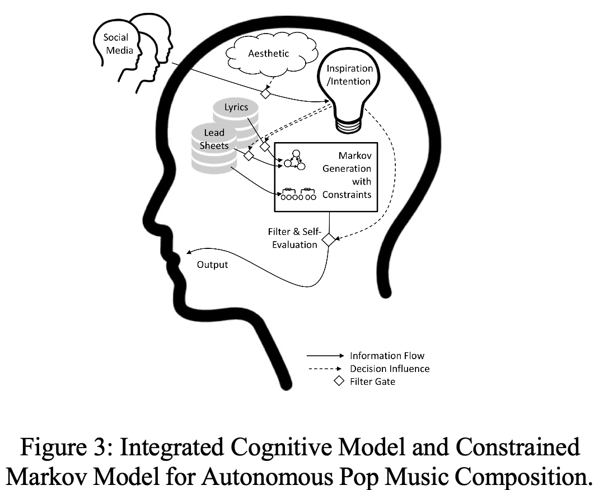
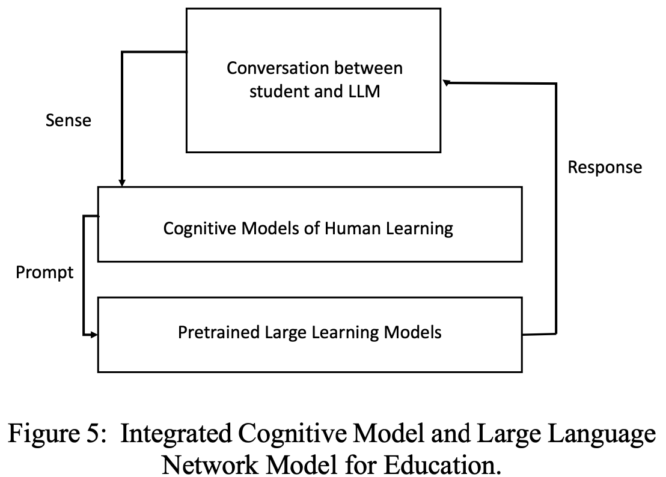
Grounding Problem
Cognitive perspective on grounding
Symbol grounding and vector grounding
Sensorimotor grounding
Embodied cognitive systems and robots
Communicative grounding
Common understanding from conversation
Epistemic grounding
Relation of lexicon to external knowledge
Relational grounding
Meaning determined in relation to other words
Combinatorial vs continuous vector space
Referential grounding
Connect representations to things in the world
Alignment, grounding and instructability

Slide 17
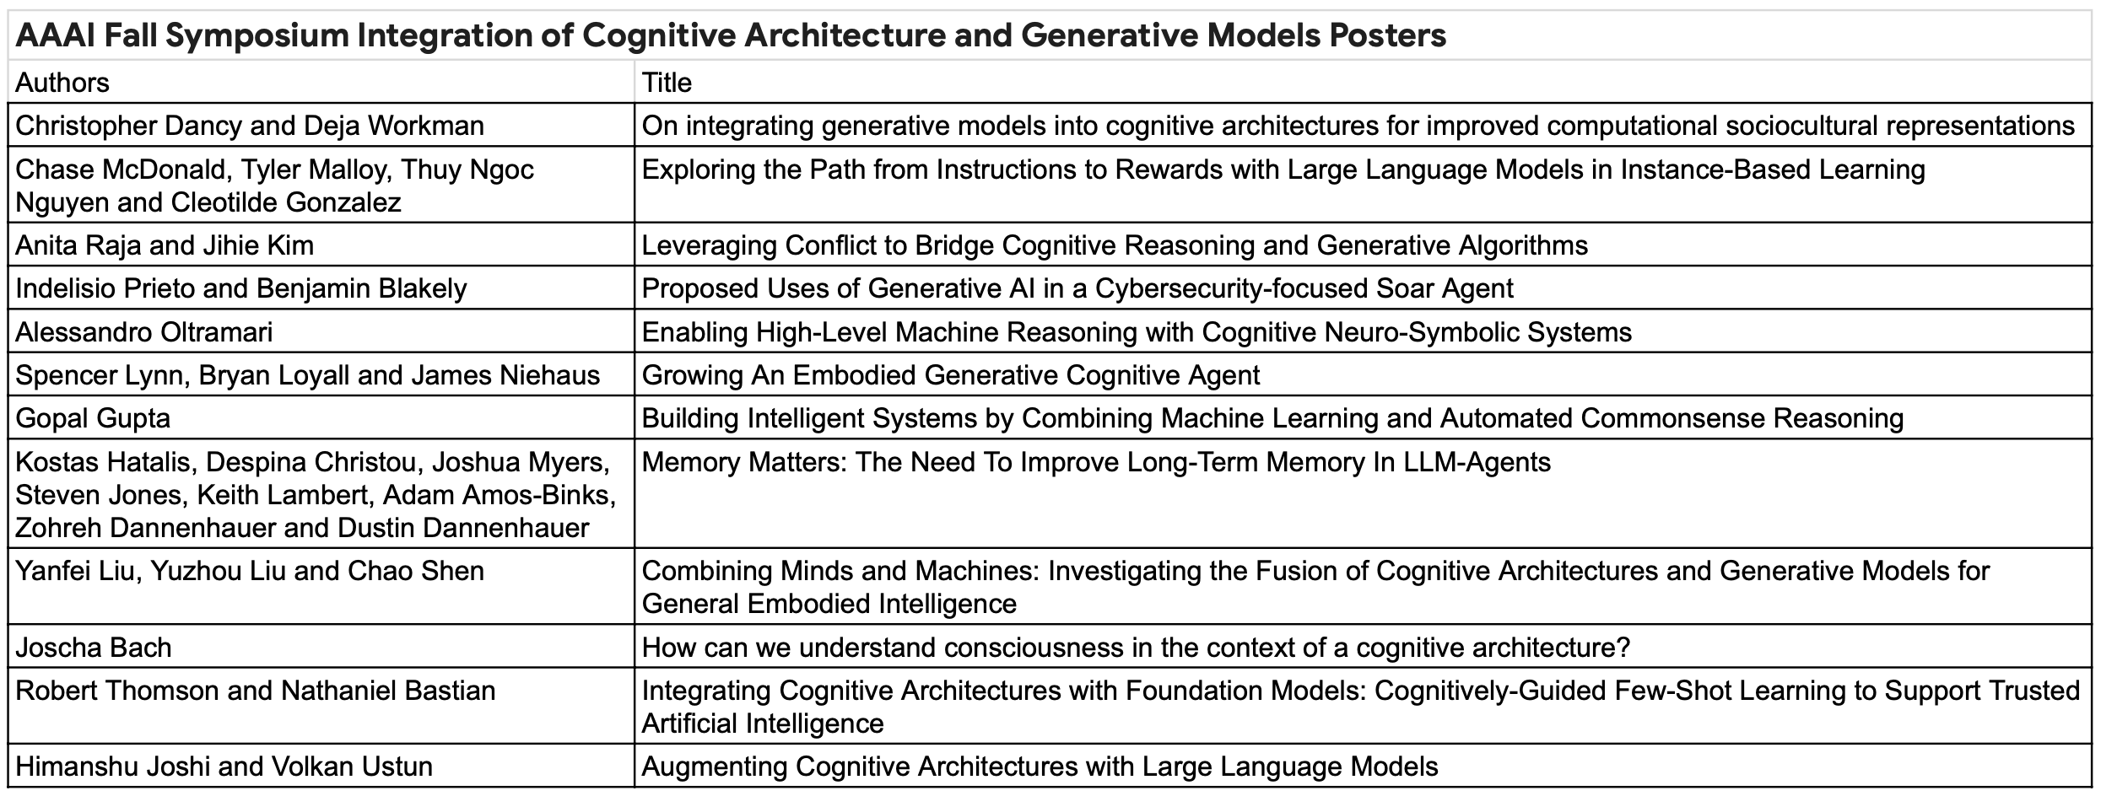
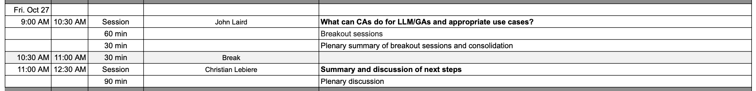
Day 3: Posters and Next Steps

Slide 18
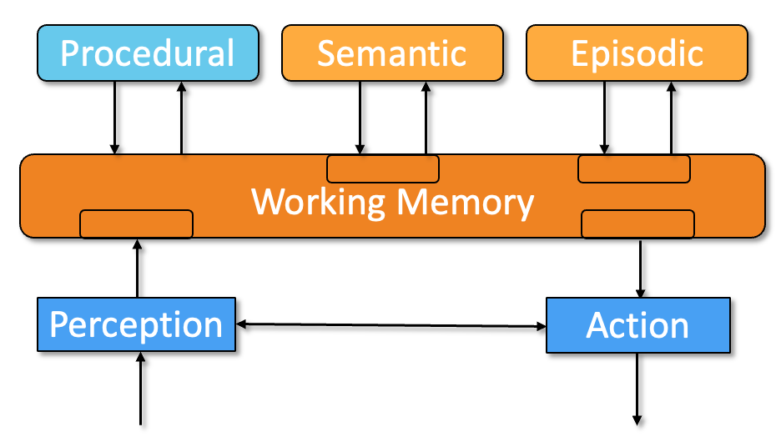
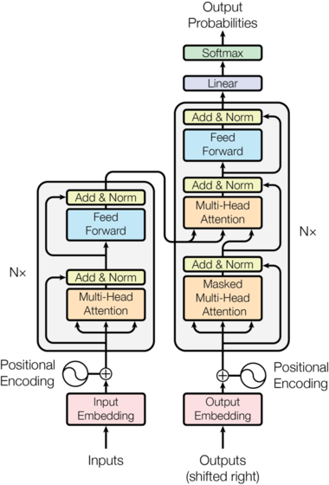
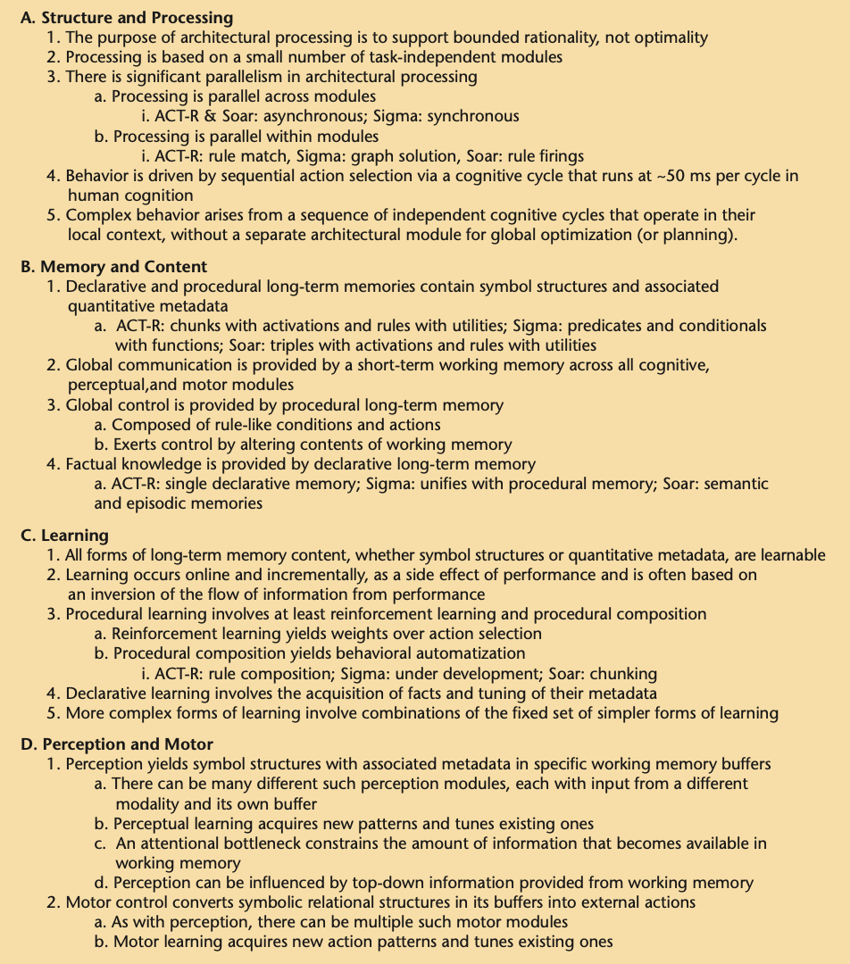
Common Model vs Generative Models
Attention is/as working memory
Token/vector is symbolic/subsymbolic
Probabilistic softmax behavior
Tuning through reinforcement learning
Time scale at deliberate act level
Next word as sequential processing
Prompting as buffer interaction
Behaviorism vs cognitivism
No long-term memory
Batch vs online learning (HC/PC)
No internal control
Human as external control (ITL)

Slide 19
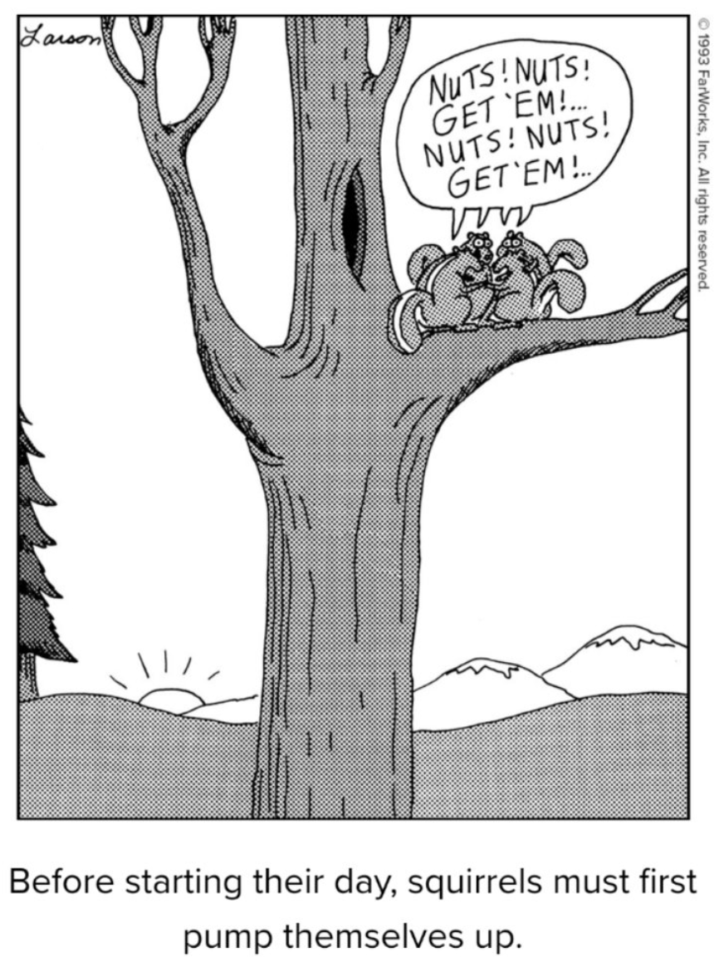
Roadmap
AI exploring space of cognitive architectures
If only there was a consensus to guide them…
How can we make CAs/CMC useful for them?
Implementations vs theory
Modular integration as low-hanging fruit
Generative models as language module
Cognitive architectures as memory module
Define agent API and control structures
Cognitive science as evaluation framework
Knowledge vs reasoning
Grounding and common sense
Yin and yang of standard benchmark tests

Slide 20
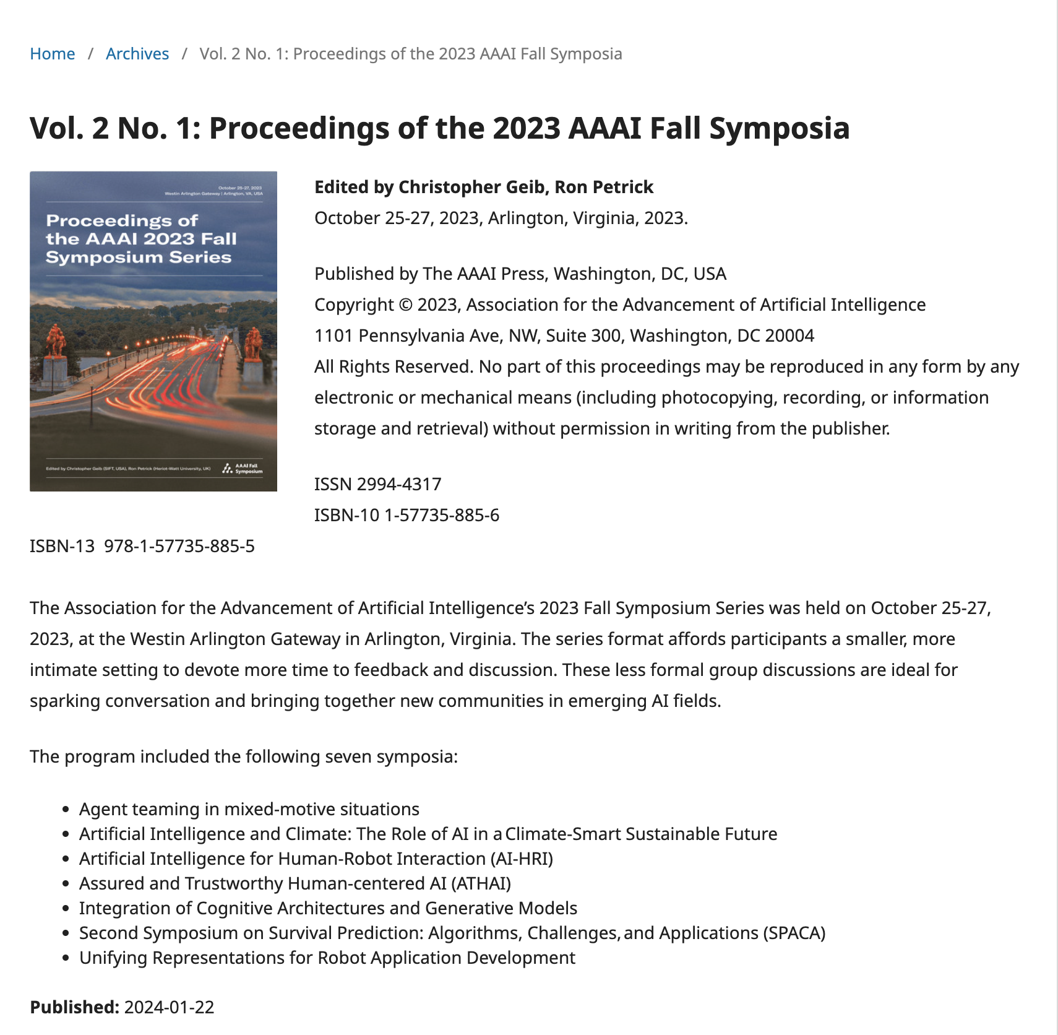
References

Slide 21
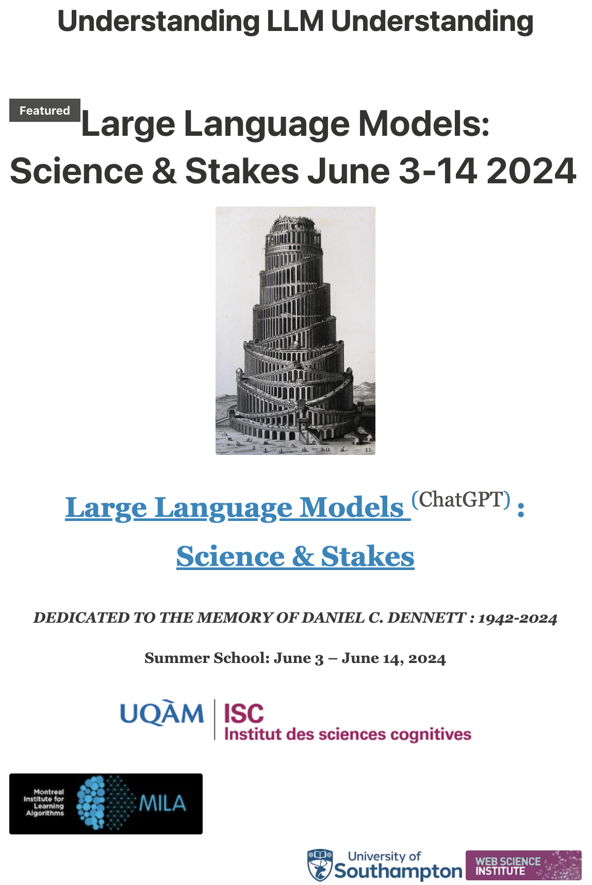
More @ skywritingspress.ca

